Slide 1

SALES FORECAST
Course and Batch: DSP–59 2022

Slide 2

OUR TEAM
Amol Sonar
Aniket Kamble
Suresh Vishwakarma
Yogesh Trivedi
Aditya Singh

Slide 3

Overview
Analyze and forecast sales of pesticides for a domestic pesticide ABC manufacturing company
Requirement Statement:-
Analyze variables that impact the sales of the product.
Understand external factors affecting sales trends of pesticide.
Build data model for the following
Conduct state wise trend analysis of the given sales.
Identify other reasons if they are influencing Pesticide sales.
Provide state wise forecast of Pesticide sales for ABC Manufacturing.

Slide 4
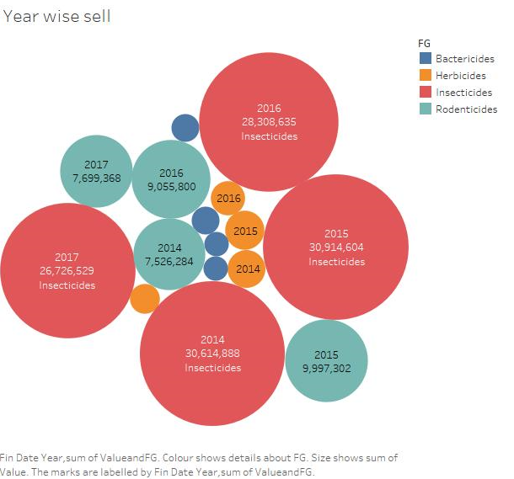
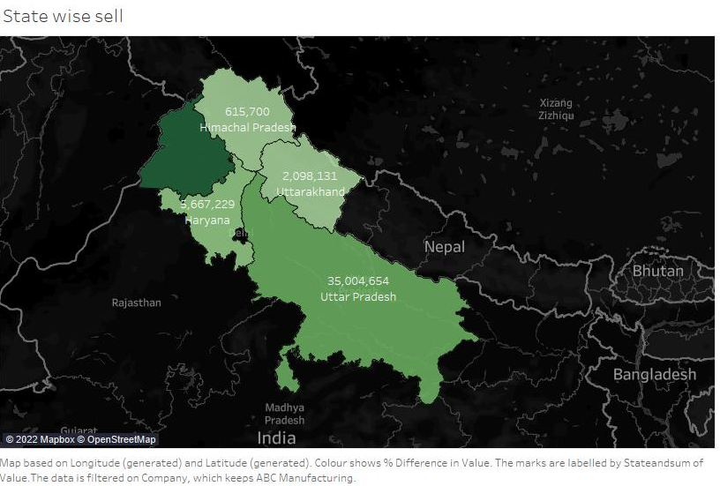
Exploratory Data Analysis
Year on Year “Insecticides” is having max sales i.e. 72% as compare to other Pesticides.
Uttar Pradesh is majorly using all type of Pesticides.
ABC Manufacturing is not selling Bactericides
Notes:
Point no. 2- Assumption due to paddy/rice crop.
Point no. 3- Weather condition (Cold)/ due to water logging crops destroy.

Slide 5
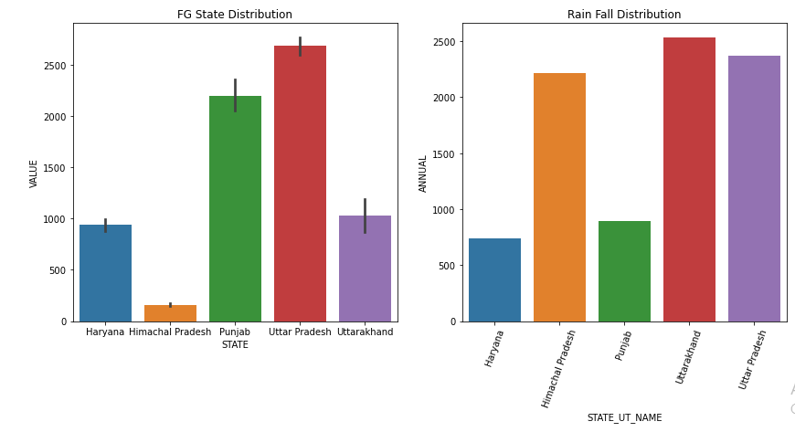
Exploratory Data Analysis
Observations:-
Inverse relationship can be seen rainfall & sell of pesticides.
Uttar Pradesh as an exception can be seen higher rainfall & higher sale of pesticides
State like Uttarakhand & Himachal Pradesh have Hilly Mountain area’s & crops grown here are sensitive to water logging.
(Rainfall data referred from website- data.gov.in)
Q4 is having Good Sale of Pesticides & we noticed low rainfall in this Qtr.
Q3 is having Average Sale of Pesticides where as rainfall is very good in this Qtr.
Notes:
Point no. 2- Assumption due to paddy/rice crop.
Point no. 3- Weather condition (Cold)/ due to water logging crops destroy.

Slide 6
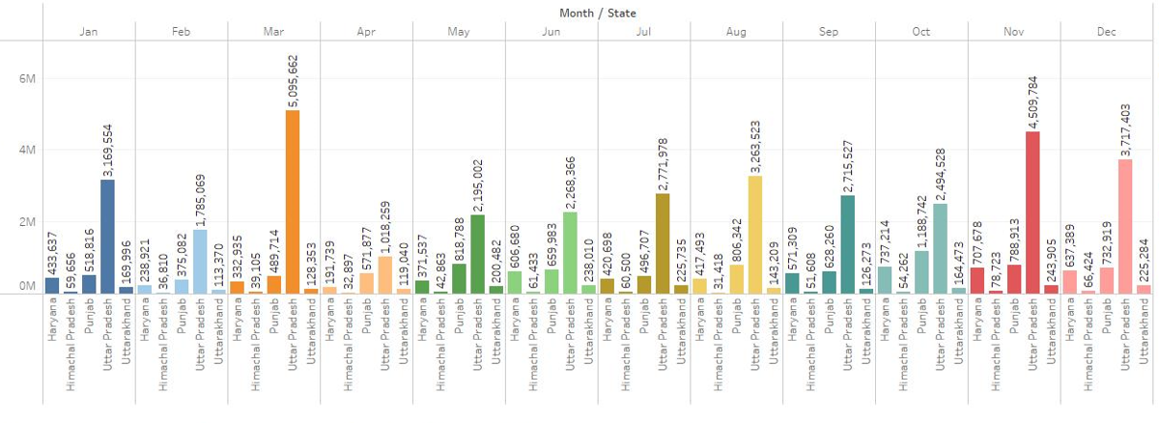
State Wise ABC Manufacturing sale

Slide 7
Model Building:
Missing Value Analysis done – No missing value found in data
Derived Final date using Fin_year & Month variable
Data type conversion for Final date.
Checked value distribution.
Sorted data on chronological order.
Grouping & Re-indexing based on Final Dates.
ReSample data on Quarter wise basis mean.

Slide 8
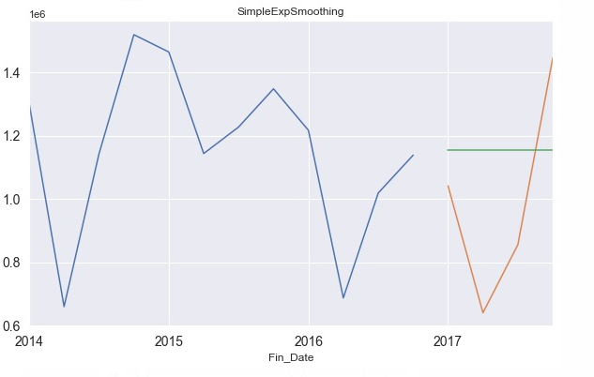
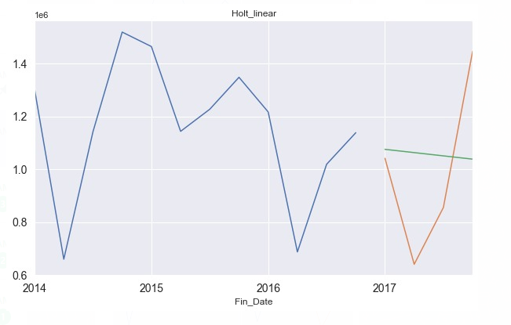
Testing and Cross-validation
Simple Exponential – aic is 302.84
Holt Linear – aic is 306.51
Aic- Akaike Information Criterion

Slide 9
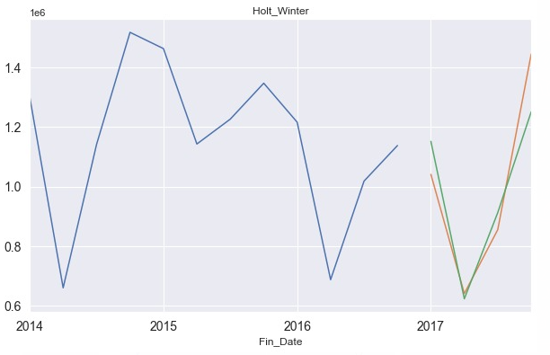
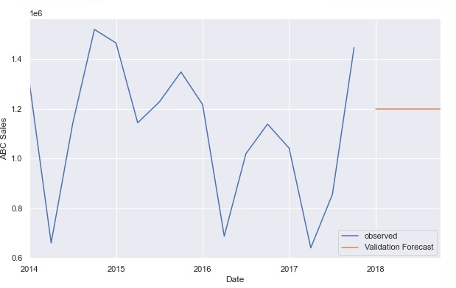
Testing and Cross-validation
ARIMA
Holt Winter- aic is 308.84

Slide 10
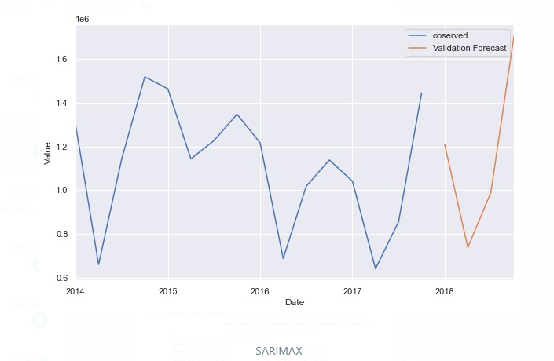
Final ModEl
SARIMAX- aic is 198.71
Notes:
The model with the lowest AIC offers the best fit

Slide 11
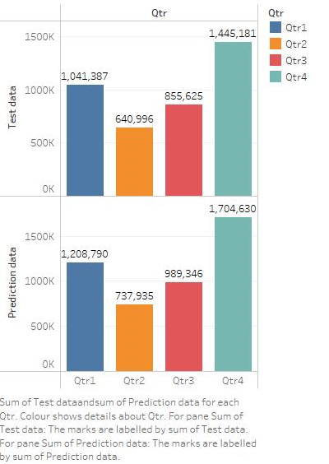
Sales Forecast

Slide 12
Thank you

